Slide 1
Coming sooner than we thought: an ice-free summertime Arctic Ocean
We used to think that the first time Arctic sea ice will go entirely away will be some summer in the 2050s (or even later), and after that an infrequent occurrence.
*https://www.nature.com/articles/s41467-023-38511-8
*http://www.climatecodered.org/2023/06/dramatic-arctic-sea-ice-news-should-not.html
https://zacklabe.files.wordpress.com/2023/08/sit_piomas_jul23.gif

Slide 2
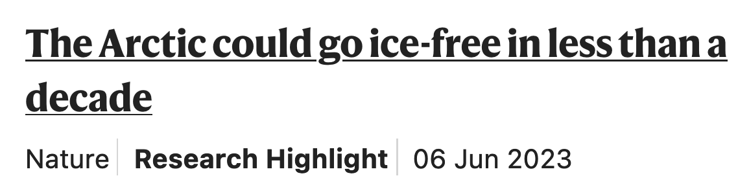
Coming sooner than we thought: an ice-free summertime Arctic Ocean
We used to think that the first time Arctic sea ice will go entirely away will be some summer in the 2050s (or even later), and after that an infrequent occurrence.
*https://www.nature.com/articles/s41467-023-38511-8
*http://www.climatecodered.org/2023/06/dramatic-arctic-sea-ice-news-should-not.html
https://zacklabe.files.wordpress.com/2023/08/sit_piomas_jul23.gif

Slide 3
Coming sooner than we thought: an ice-free summertime Arctic Ocean
We used to think that the first time Arctic sea ice will go entirely away will be some summer in the 2050s (or even later), and after that an infrequent occurrence.
The last ice-free Arctic summer was ~130,000 years ago, when parts of the Greenland ice sheet went away and the West Antarctic Ice Sheet slipped into the ocean, bringing meters of sea level rise.
*https://www.nature.com/articles/s41467-023-38511-8
*http://www.climatecodered.org/2023/06/dramatic-arctic-sea-ice-news-should-not.html
https://zacklabe.files.wordpress.com/2023/08/sit_piomas_jul23.gif

Slide 4
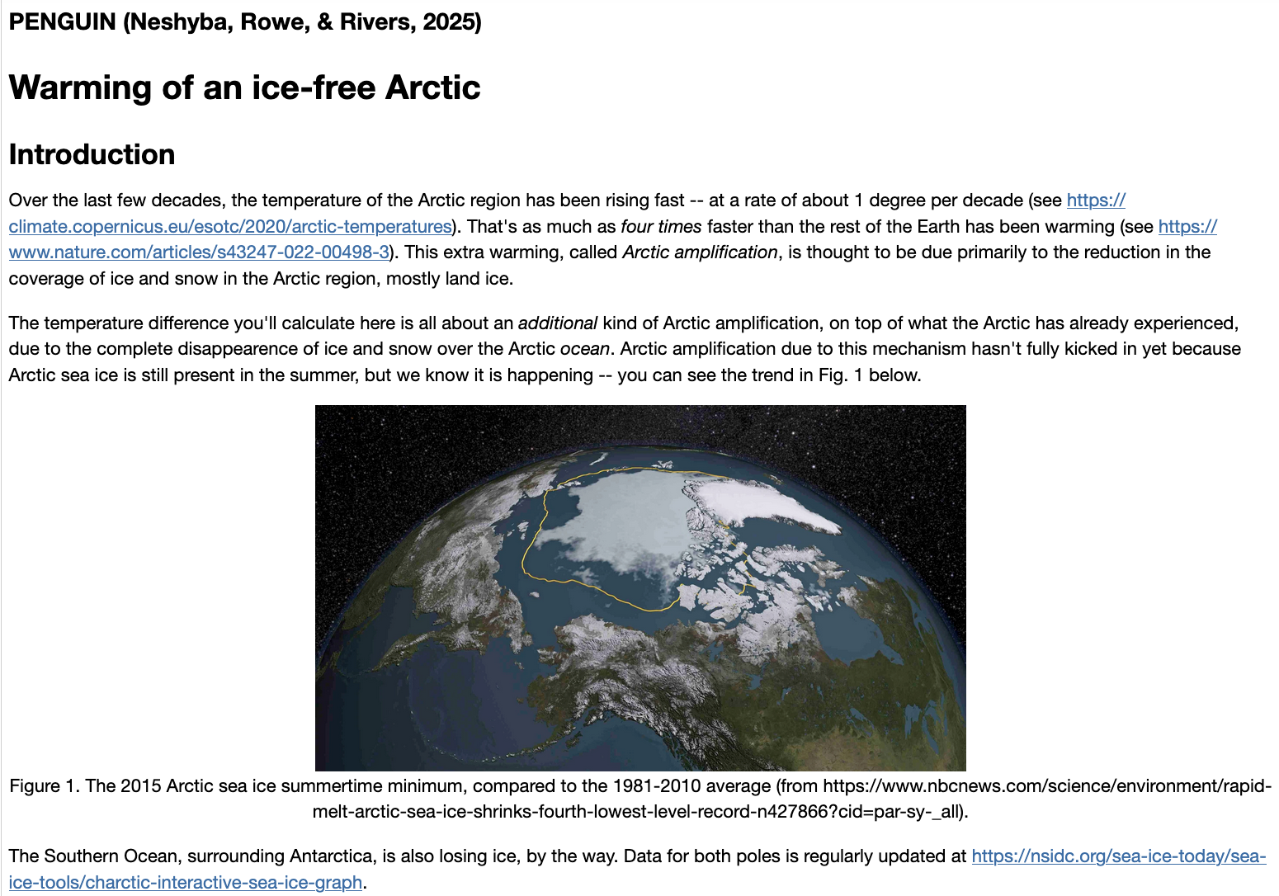
To do sometime next week

